Slide 1
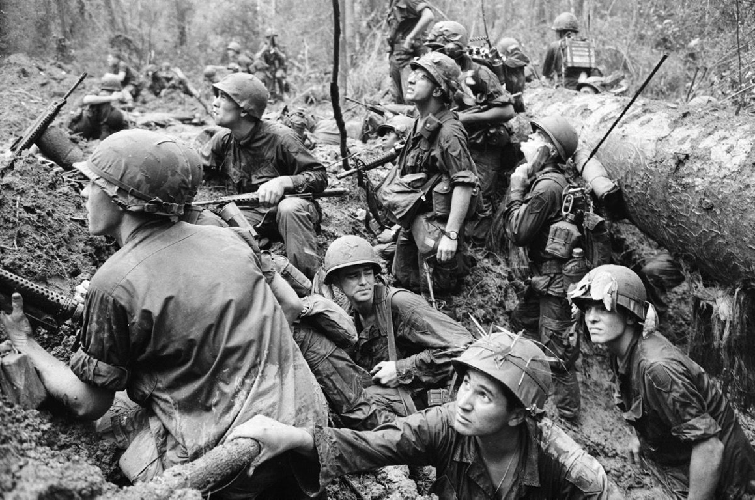
The Vietnam War
America Comes of Age

Slide 2
Significance
America’s longest war
--1940s-1975
--6 Presidents: Truman, Eisenhower, JFK, Johnson, Nixon, Ford
American losses
--2.5 million served; 58,000 died
--$120 billion
--only war ever lost
Vietnamese losses
--4 million civilians & soldiers died (10% of population)
--division of families, loyalties, nationalism
“Vietnam Syndrome” Kissinger: “Vietnam is still with us. It has created doubts about American judgment, American credibility, about American power—not only at home, but throughout the world.”

Slide 3
Origins
Vietnamese Imperialism
--Chinese, French, Japanese, French, American
Vietnamese Resistance
--China: Trung sisters (unsuccessful) 4 AD
--French, Japanese & Americans: Nguyen Ai Quoc (Ho Chi Minh) & the Viet Minh
--Dien Bien Phu 1954: defeat the French
--Geneva Accords
--North VN: Ho Chi Minh
--South VN: Ngo Dinh Diem
--in 2 years national election & chance for unification

Slide 4
Early US Involvement
Truman: Truman Doctrine & support ally, the French
Eisenhower: Domino Theory--basis for intervention & cited by every President during the war
--1949 first “advisors” 675
Kennedy
--1961: increases advisors to from 1000 to 16,000
--1963: tacitly backs coup of Diem

Slide 5
Johnson’s War
Inherits & escalates war
1964 Gulf of Tonkin: gave Johnson power to send troops w/o declaration of war
1965 Operation Rolling Thunder
—Westmoreland
—carpet bomb North Vietnam
—200,000 more troops; 1966: 200,000 more
—> by end of 1967, 500,000 troops in Vietnam

Slide 6
Challenges
Guerilla Warfare
—environment
—hit & run attacks; no front lines
—“cling to the enemy’s belt”: close combat so that air & artillery strikes risk own troops
—tunnels, land mines, booby traps (them)
—Agent Orange & napalm (us)
War of Attrition (body count)
—search & destroy missions: “we must destroy it in order to save it”
—80% of people killed in US bombings were civilians—“hearts and minds?”
Friend or enemy?
—farmer by day, VC by night
—enemy is everywhere
—US owned the day; VC the night

Slide 7
Vietnamese Strengths
Determination
—long history of resisting outside influence (Chinese, French, Japanese)
Willingness to make huge sacrifices
—keep fighting; goal is to exhaust the enemy
—“You can kill 10 of my meant for every 1 of yours, and we will win.”
Ho Chi Minh Trail
—complex of paths/trails from NVN to SVN via Cambodia & Laos

Slide 8
American Public Support
Anti-War Demonstrations
—1965 start; 1st major protest in DC
—colleges: sit-ins, teach-ins
—Kent State (Ohio) & Jackson State (Miss)—students killed by Nat’l Guard & police
—1969: protest in DC drew 500,000
Purpose?
—Why are we there?
—another country’s civil war
—130,000 Vietnamese civilians dying per month
Power of image
—1st TV war
—iconic photographs
Draft Resistance
—500,000 men avoided the draft
American Leaders
—Mohammed Ali, MLK
—Walter Cronkite (more trusted than God): “If I’ve lost Cronkite, I’ve lost America.”

Slide 9
1968
Tet Offensive
—truce for Tet (Vietnamese New Year) but VC launches surprise attack in South
—more than 100 cities/towns incl. capitol
—US embassy in Saigon
—military defeat for VC (2000 US v. 50,000 VC)
VC can be anywhere; can we win? turned public against war
cut domestic budget (Great Society) & increase taxes
Johnson won’t run for re-election
My Lai Massacre
—US massacres village of My Lai—200 women, children, elderly
—Lt. Calley: “no big deal”
—morale plummets; US looks like bully; “hearts and minds?”
—government credibility plummets

Slide 10
End
“Vietnamization” of war
—transfer responsibility of war to SVN
—reduce troops from 28.000 in 1970 to 140,00 in 1971
—start peace talks with NVN
Secret bombings
—1969 Nixon secretly bombs neutral Cambodia
—Drop more bombs on Cambodia than we did in WW2
—spreads to Laos in 1970
Peace Talks 1973
—cease-fire & US troops leave Saigon
—stop bombing Laos & Cambodia
—both sides violate; US provides $ but no troops
Evacuation 1975
—SVN leader resigns & flees to London
—US evacuates
—April 30, South Vietnam surrenders

